Slide 1
Operation Sequence for Pole 2 Deblock AND Breaker/Filter/Line Maintenance
14 July 2021

Slide 2
Contents
Operation Sequence for
Pole 2 Deblock
F1B1 Maintenance
B1Q1 Maintenance
Lahore South-I Line Maintenance
132kV Line 2 Maintenance

Slide 3
Pole 2 Deblock

Slide 4
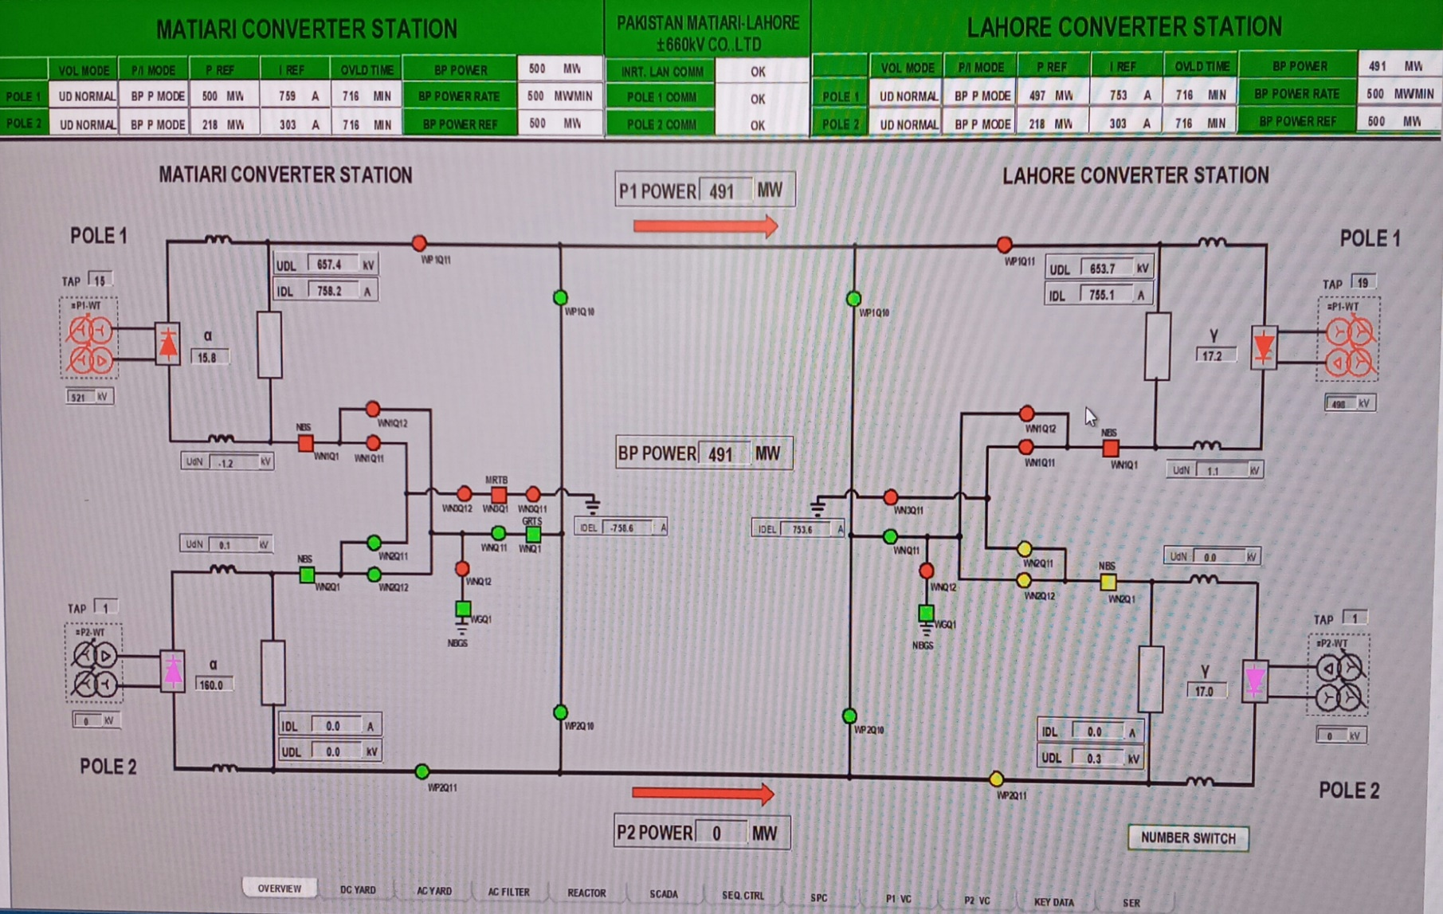
Initial State: Overview
Pole 2 is Blocked. Pole 1 Operates in Ground return Mode
Valve | BLOCKED
Conv. T/F | De-energized
Pole 2 NBS | OPEN
Pole 2 Neutral bus WN2Q11, WN2Q12 | OPEN
Pole 2 bus WP2Q11 | OPEN

Slide 5
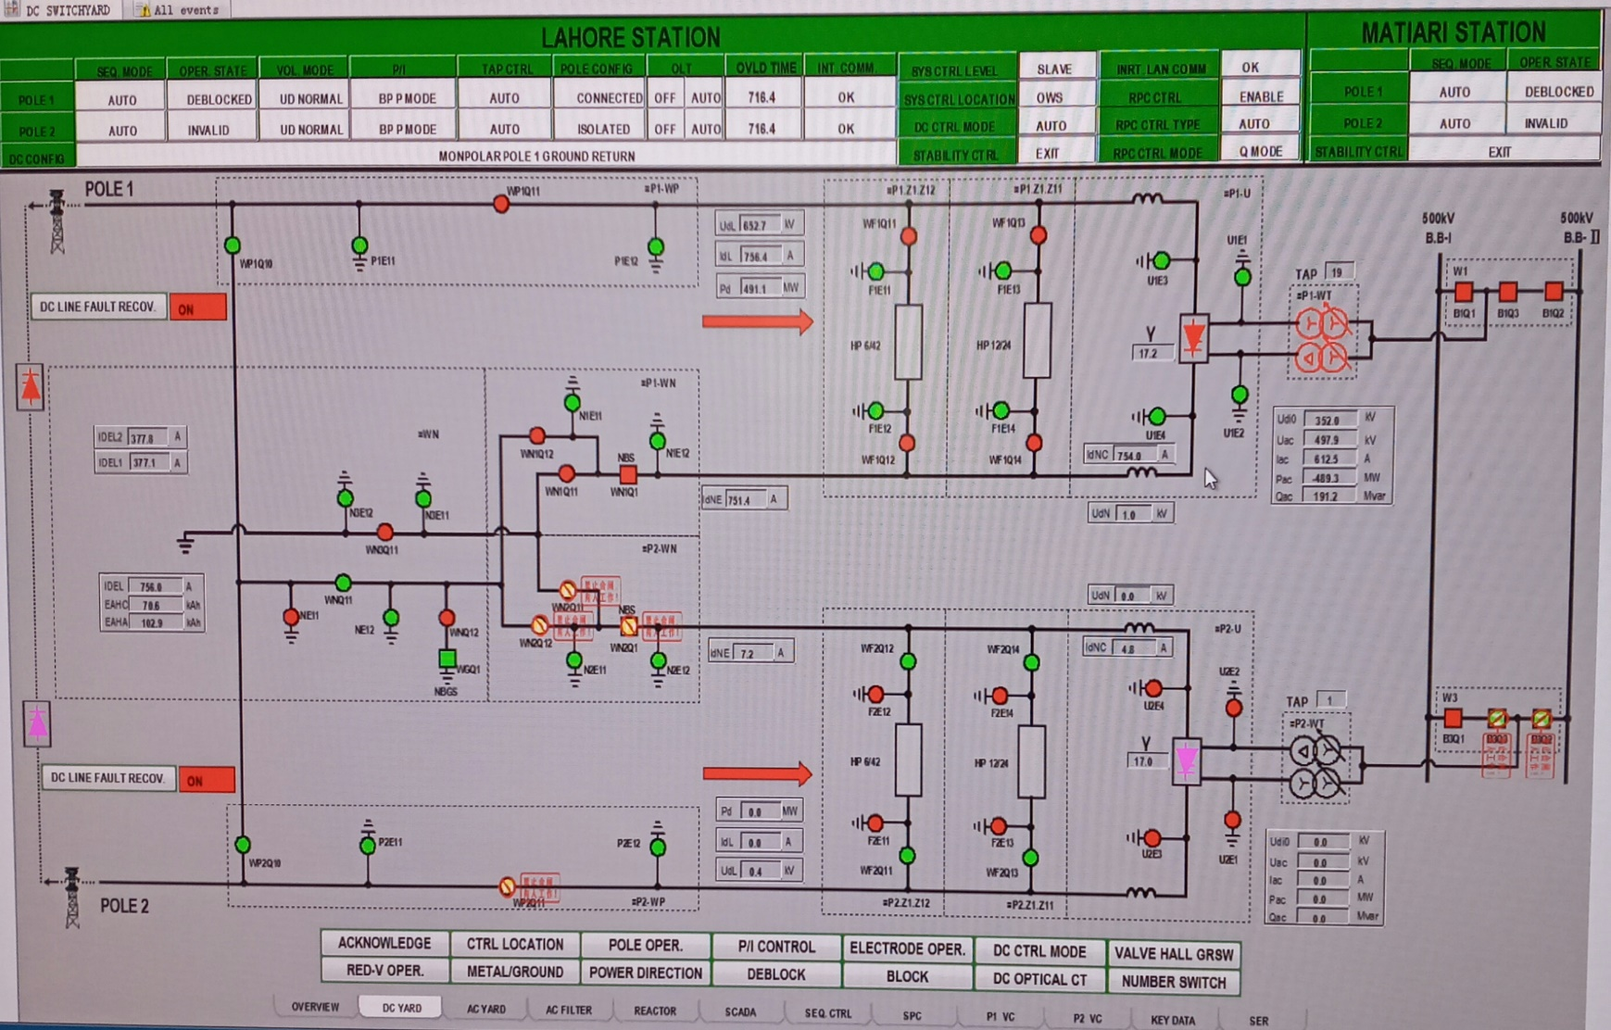
Initial State: DC Yard
Pole 2 Valve is Blocked. Converter T/F is De-Energized
Valve Hall Earth Switches | CLOSED
DC Filter 1 and 2 | Disconnected and Earthed
Converter Transformer Breakers B3Q2, B3Q3 | OPEN
Pole 2 NBS | OPEN
Pole 2 Neutral bus WN2Q11, WN2Q12 | OPEN
Pole 2 bus WP2Q11 | OPEN

Slide 6
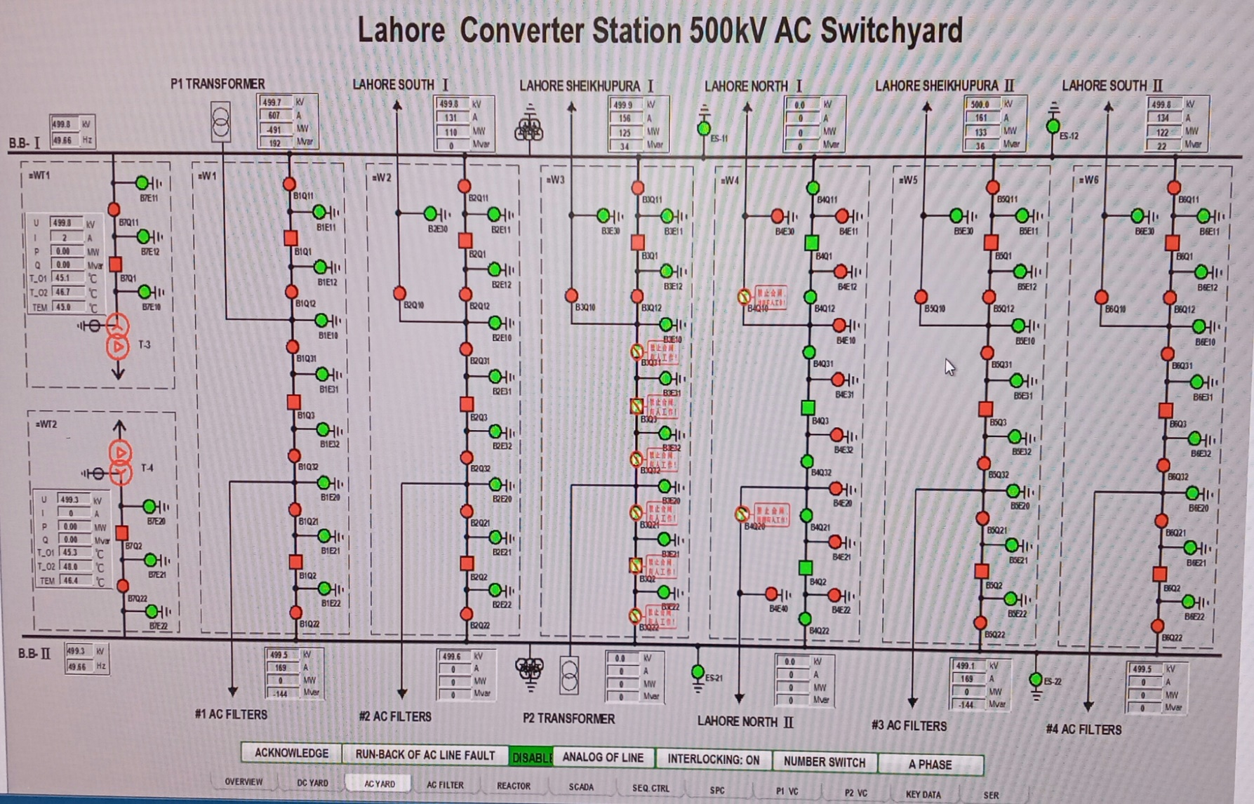
Initial State: AC Yard
Pole 2 Converter T/F is Disconnected from B.B.1 and B.B.2
Pole 2 Converter T/F Breakers B3Q2, B3Q3 | OPEN
Isolators B3Q21, B3Q22, B3Q31, B3Q32 | OPEN
Earth Switches B3E20, B3E21, B3E22, B3E31, B3E32 | OPEN

Slide 7
Switch Interlocking
OPERATION |  | INTERLOCKING CONDITION
P2.WN-Q11 | ON | =P2-WN-Q21∧=P2.WN-Q22∧=P2-WP-Q21∧=WN-Q21∧(=S1-WN-Q2∧=WN-Q1∨=P2-WN-Q1)
 | OFF | =P2-WN-Q1
P2.WN-Q12 | ON | =P2-WN-Q1∧=P2-WN-Q21∧=P2.WN-Q22∧=P2-WP-Q21∧=WN-Q22
 | OFF | =P2-WN-Q1∨=WN-Q13
P2-WN-Q1 | ON | 1
 | OFF | (P2BLK ∨ P2ESOF) ∧ P2Idne <102.4% ∧ P2Udl ≤3%
P2-WP-Q11 | ON | =P2-WP-Q21∧=P2-WP-Q22∧=P2-WP-Q12∧= P2-WN-Q1 ∧[=P2.WN-Q11 ∧=WN-Q11 ∧=WN-Q1 ∨=WN-Q13∧=P2.WN-Q12 ∧ (=WN-Q12∨=P1-WP-Q12) ∨=P2. WN-Q11∧=WN-Q12∧ =P1-WP-Q12 ∧=WN.Q13∧=S1-P2-WP-Q22∧S1-P2 OLT OFF
 | OFF | P2BLK∧ P2Idl ≤2%

Slide 8
Sequence Control
Equipment and main systems of inverter station | Status
 | Overhaul status | Cold standby state | Hot standby state | Deblock operation state
VCE | / | / | OK | OK
Valve cooling control system | / | Operation | Operation | Operation
Control and protection system | / | / | OK | OK
Interlocking of valve hall key | Release | Locked | Locked | Locked
Earthing switch in valve hall | Closing | Opening | Opening | Opening
Converter transformer incoming line earthing switch | Closing | Opening | Opening | Opening
Converter transformer incoming line circuit breaker | Opening | Opening | Closing | Closing
Converter transformer incoming line disconnector | Opening | Opening | Closing | Closing
Converter transformer tap changer position | / | Start gear | Proper gear | Proper gear
Converter transformer cooling system | / | / | Operation | Operation
DC filter | Earthed | Unearthed | Available | Available
AC filter | Earthed | Unearthed | Available | Available
DC switchyard configuration | Earthed | Unearthed | Connection | Connection

Slide 9
Deblock Sequence
STEP | Sequence description | Monitoring time
STEP0 initialization
STEP10 maintenance state
20 | Lock the valve hall key | 3s
25 | Check the valve hall interlocking | 1s
40 | Open the earthing switch at DC side of valve hall | 3min
40 | Open the earthing switch at AC side of valve hall | 3min
50 | Open the converter transformer incoming line earthing switch | 60s
70 | Tap changer to start gear | 10min
80 | Start of valve cooling system | 30s
STEP200 cold standby state
203 | Check the inter-station communication for normal or in station level | 3s
205 | Start the converter transformer cooling system | 100s
210 | Check the DC filter configuration for normal | 3min
215 | Check the DC switchyard configuration for OK | 30min
217 | Start the smoothing reactor cooling system | 30s
220 | Check that the valve cooling system is ready | 100s
222 | Close the converter transformer incoming line disconnector | 100s
228 | Close the converter transformer incoming line circuit breaker | 30s
240 | Check the DC switchyard configuration for OK | 30min
245 | AC filter available | 30s
248 | Converter transformer tap changer gets ready | 10min
STEP300 hot standby state
315 | Check the AC filter for OK | 2s
318 | Minimum filter enabled | 30s
320 | Start the normal deblock of closed-loop control | 15s
STEP400 deblock operation state

Slide 10
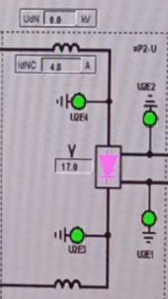
Pole 2 deblock: Step 1
Open Valve Hall Earth Switches
Open U2E1, U2E2
Open U2E3, U2E4

Slide 11
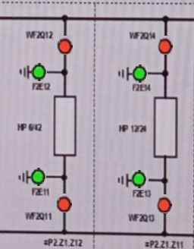
Pole 2 deblock: Step 2
2. Connect DC Filter 1 and 2
Open F2E11, F2E12, F2E13, F2E14
Close WF2Q11, WF2Q12, WF2Q13, WF2Q14 (Automatic)

Slide 12
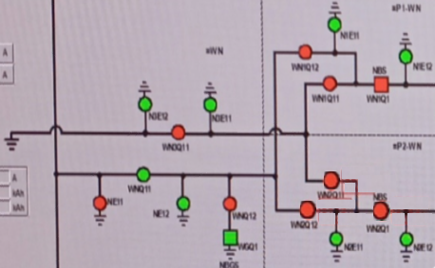
Pole 2 deblock: Step 3
3. Close Pole 2 Neutral Bus Switches
Close WN2Q11, WN2Q12
CloseWN2Q1 (Automatic)

Slide 13
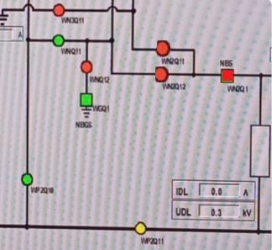
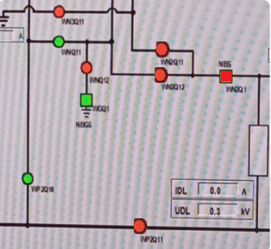
Pole 2 deblock: Step 4
4. Close Pole 2 Bus Switch WP2Q11

Slide 14

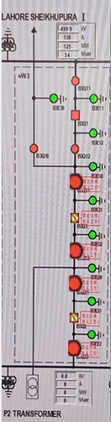
Pole 2 deblock : Step 5
5. Close Pole 2 Converter Transformer B.B. 1 and B.B. II Isolators

Slide 15
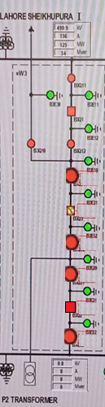
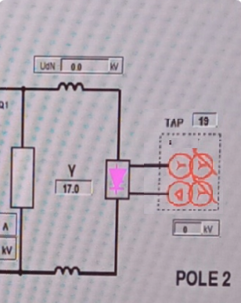
Pole 2 deblock : Step 6
6. Close B.B. 1I Breaker B3Q2 to Energize Pole 2 Converter Transformer

Slide 16
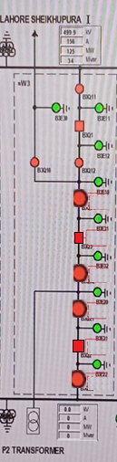
Pole 2 deblock : Step 7
7. Close Pole 2 Converter Transformer B.B. 1 Breaker B3Q3

Slide 17
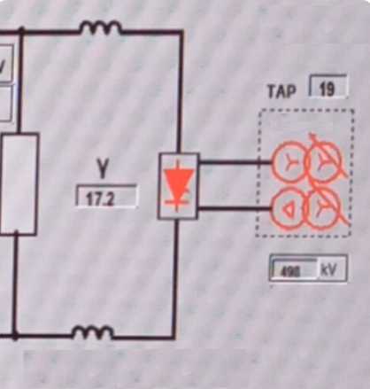
Pole 2 deblock : Step 8
8. Master Station will Deblock Pole 2 Valve

Slide 18
F1B1 Maintenance

Slide 19
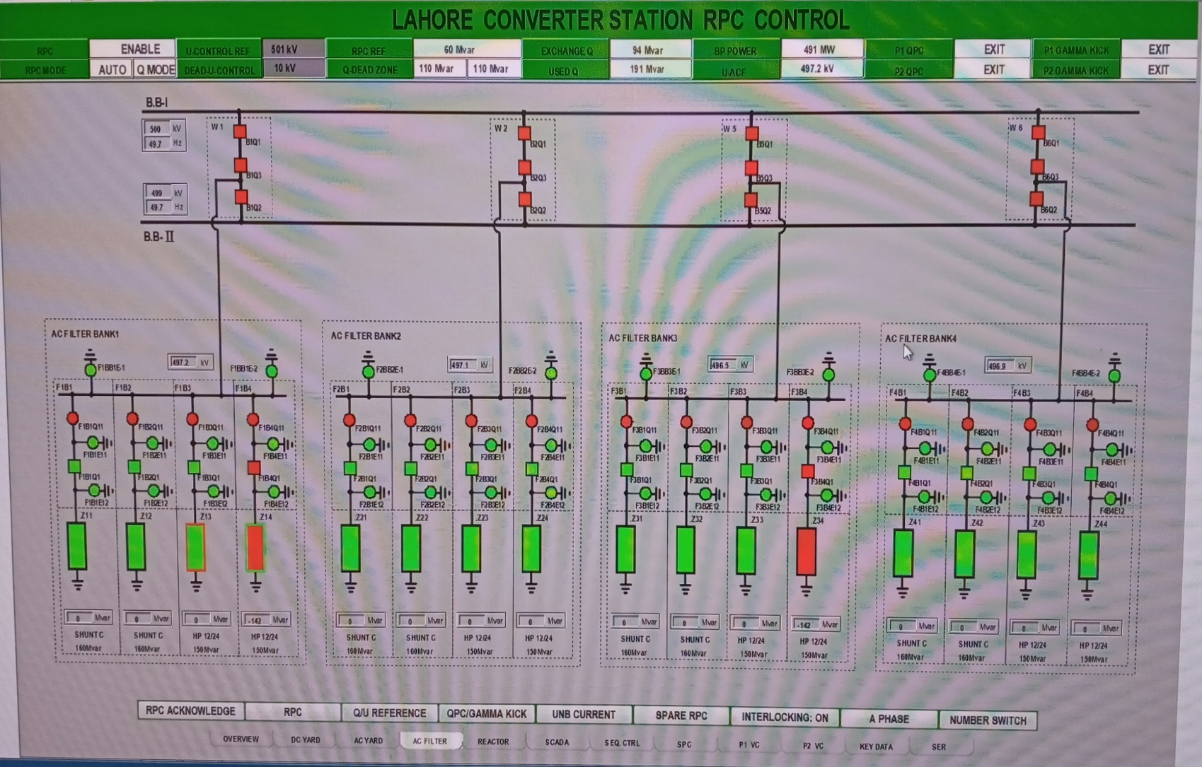
Initial State: AC Filter Yard
ACF F1B1 | Disconnected
Breaker F1B1Q1 | OPEN
Isolator F1B1Q11 | CLOSED
Earthing Switches F1B1E11, F1B1E12 | OPEN

Slide 20
Interlocking Conditions
Operation |  | Conditions
Isolator F1B1Q11 | CLOSE | F1BB1E-1 OPEN, F1BB1E-2 OPEN F1B1E11 OPEN, F1B1E12 OPEN F1B1Q1 OPEN
 | OPEN | F1B1Q1 OPEN
Circuit Breaker F1B1Q1 | CLOSE | F1B1Q11 CLOSED SC end of discharge
 | OPEN | 1
Earthing Switch F1B1E11 | CLOSE | F1B1Q11 OPEN
Earthing Switch F1B1E12 | CLOSE | F1B1Q11 OPEN > 420s

Slide 21
F1B1 Maintenance: Step 1
1. Open F1B1Q1 (Already Open)

Slide 22
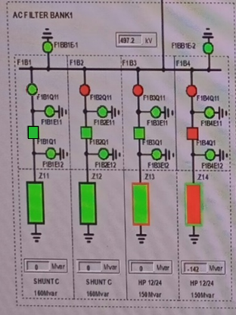
F1B1 Maintenance: Step 2
2. Open Isolator F1B1Q11

Slide 23
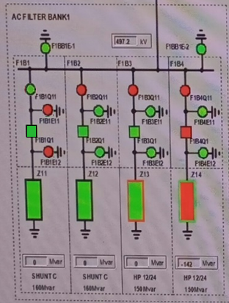
F1B1 Maintenance: Step 3
3. Close Earthing Switches F1B1E11 and F1B1E12

Slide 24
B1Q1 Maintenance

Slide 25
Initial State: AC Yard
Pole 1 Transformer | Connected
B.B. Breakers B1Q1 | CLOSED
Isolators B1Q11, B1Q12 | CLOSED
Earth Switches B1E11, B1E12 | OPEN

Slide 26
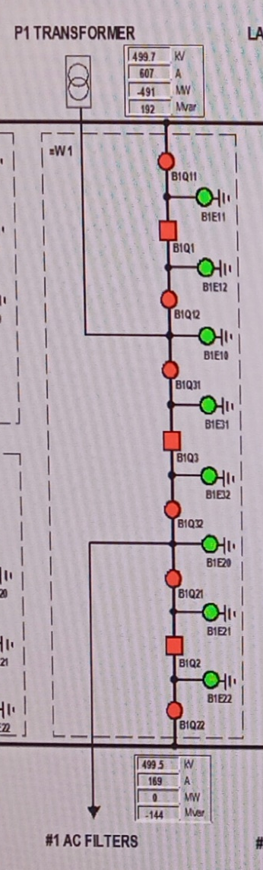
Interlocking Conditions
Operation |  | Conditions
Isolator B1Q11, B1Q12 | CLOSE | B1Q1 OPEN
 | OPEN | B1Q1 OPEN
Circuit Breaker B1Q1 | CLOSE | B1Q11 CLOSED, B1Q12 CLOSED
 | OPEN | 1
Earthing Switch B1E11 | CLOSE | B1Q11 OPEN, B1Q12 OPEN
Earthing Switch B1E12 | CLOSE | B1Q11 OPEN, B1Q12 OPEN

Slide 27
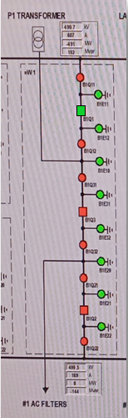
B1Q1 Maintenance: Step 1
1. Open Circuit Breaker B1Q1

Slide 28
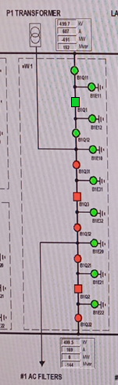
B1Q1 Maintenance: Step 2
2. Open Isolators B1Q11 and B1Q12

Slide 29
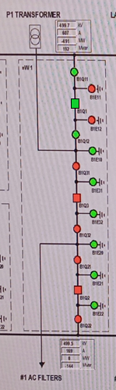
B1Q1 Maintenance: Step 3
3. Close Earthing Switches B1E11 and B1E12

Slide 30
Lahore SOUTH-I Line Maintenance

Slide 31
Initial State: AC Yard
Lahore South 1 Line | Connected
B.B. Breakers B2Q1, B2Q3 | CLOSED
Isolators B2Q10, B2Q11,B2Q12, B2Q31,B2Q32 | CLOSED
Earth Switches B2E10, B2E30, B2E11, B2E12, B2E31, B2E32 | OPEN

Slide 32
Interlocking Conditions
Operation |  | Conditions
Isolator B2Q11, B2Q12 | CLOSE | B2Q1 OPEN
 | OPEN | B2Q1 OPEN
Isolator B2Q31, B2Q32 | CLOSE | B2Q3 OPEN
 | OPEN | B2Q3 OPEN
Circuit Breaker B2Q1 | CLOSE | B2Q11 CLOSED, B2Q12 CLOSED
 | OPEN | 1
Circuit Breaker B2Q3 | CLOSE | B2Q31 CLOSED, B2Q32 CLOSED
 | OPEN | 1
Earthing Switch B2E11, B2E12 | CLOSE | B2Q11 OPEN, B2Q12 OPEN
Earthing Switch B2E31, B2E32 | CLOSE | B2Q31 OPEN, B2Q32 OPEN

Slide 33
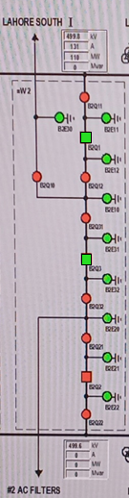
Lahore S-I Maintenance: Step 1
1. Open Circuit Breakers B2Q1 and B2Q3

Slide 34
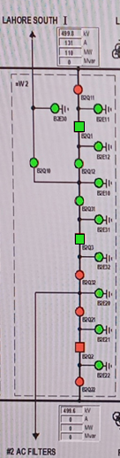
Lahore S-I Maintenance: Step 2
2. Open Circuit Isolators B2Q12, B2Q31 and B2Q10

Slide 35
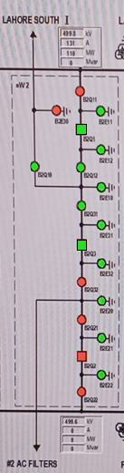
Lahore S-I Maintenance: Step 3
3. Contact Lahore South I Station. After permission, close Earthing Switch B2E30

Slide 36
132 kV Line 2 Maintenance

Slide 37
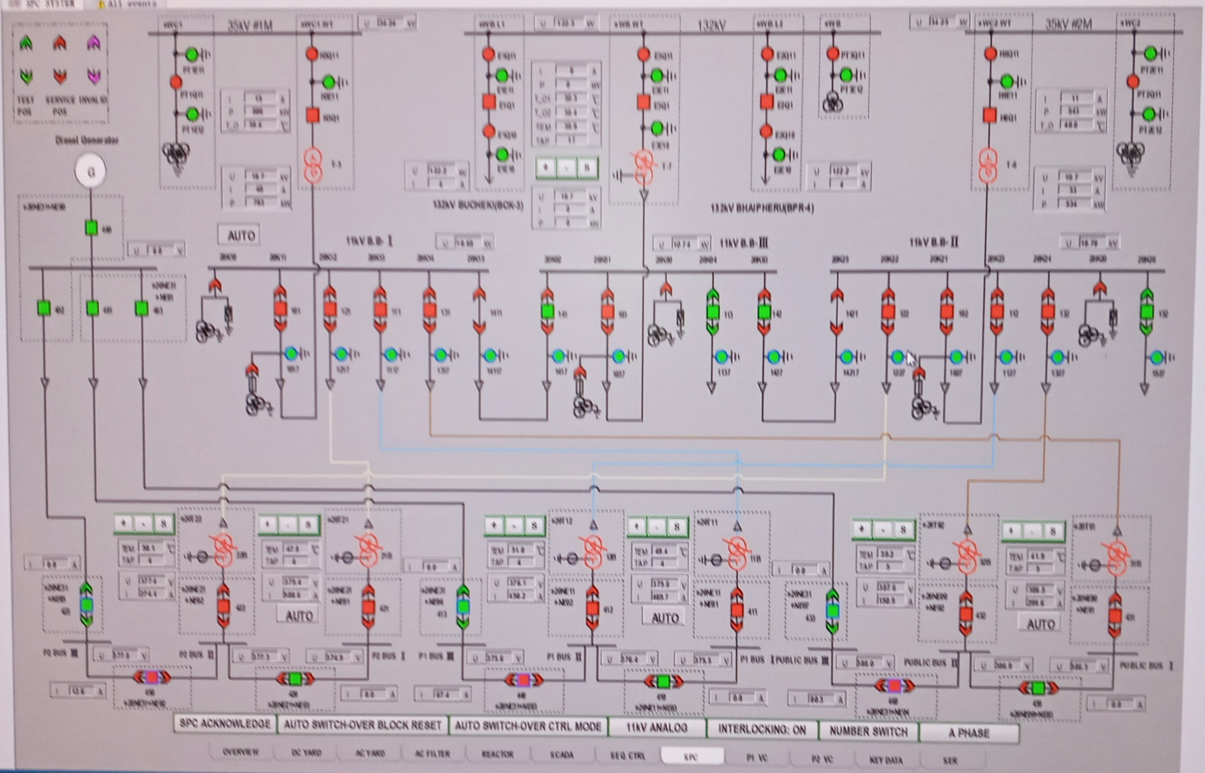
INITIAL State: SPC
132 kV Line 2 | Connected
Breaker E2Q1 | CLOSED
Isolators E2Q10,E2Q11 | CLOSED
Earthing Switches E2E10, E2E11 | OPEN

Slide 38
Interlocking Conditions
Operation |  | Conditions
Isolator E2Q11, E2Q12 | CLOSE | E2Q1 OPEN
 | OPEN | E2Q1 OPEN
Circuit Breaker E2Q1 | CLOSE | E2Q11 CLOSED, E2Q12 CLOSED
 | OPEN | 1
Earthing Switch E2E10 | CLOSE | E2Q11 OPEN, E2Q12 OPEN
Earthing Switch E2E11 | CLOSE | E2Q11 OPEN, E2Q12 OPEN

Slide 39
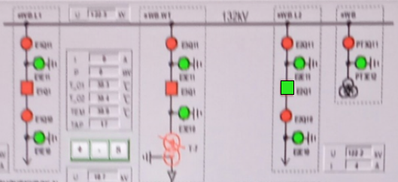
132 kV Line 2 Maintenance: STEP 1
1. Open Circuit Breaker E2Q1

Slide 40
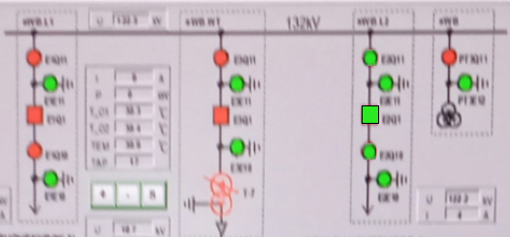
132 kV Line 2 Maintenance : STEP 2
2. Open Isolators E2Q10 and E2Q11

Slide 41
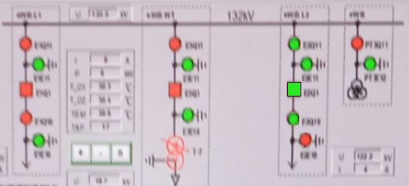
132 kV Line 2 Maintenance : STEP 3
3. Contact RCC. After permission, close Earthing Switch E2E10

